Slide 1
Prototipo

Slide 2


Slide 3
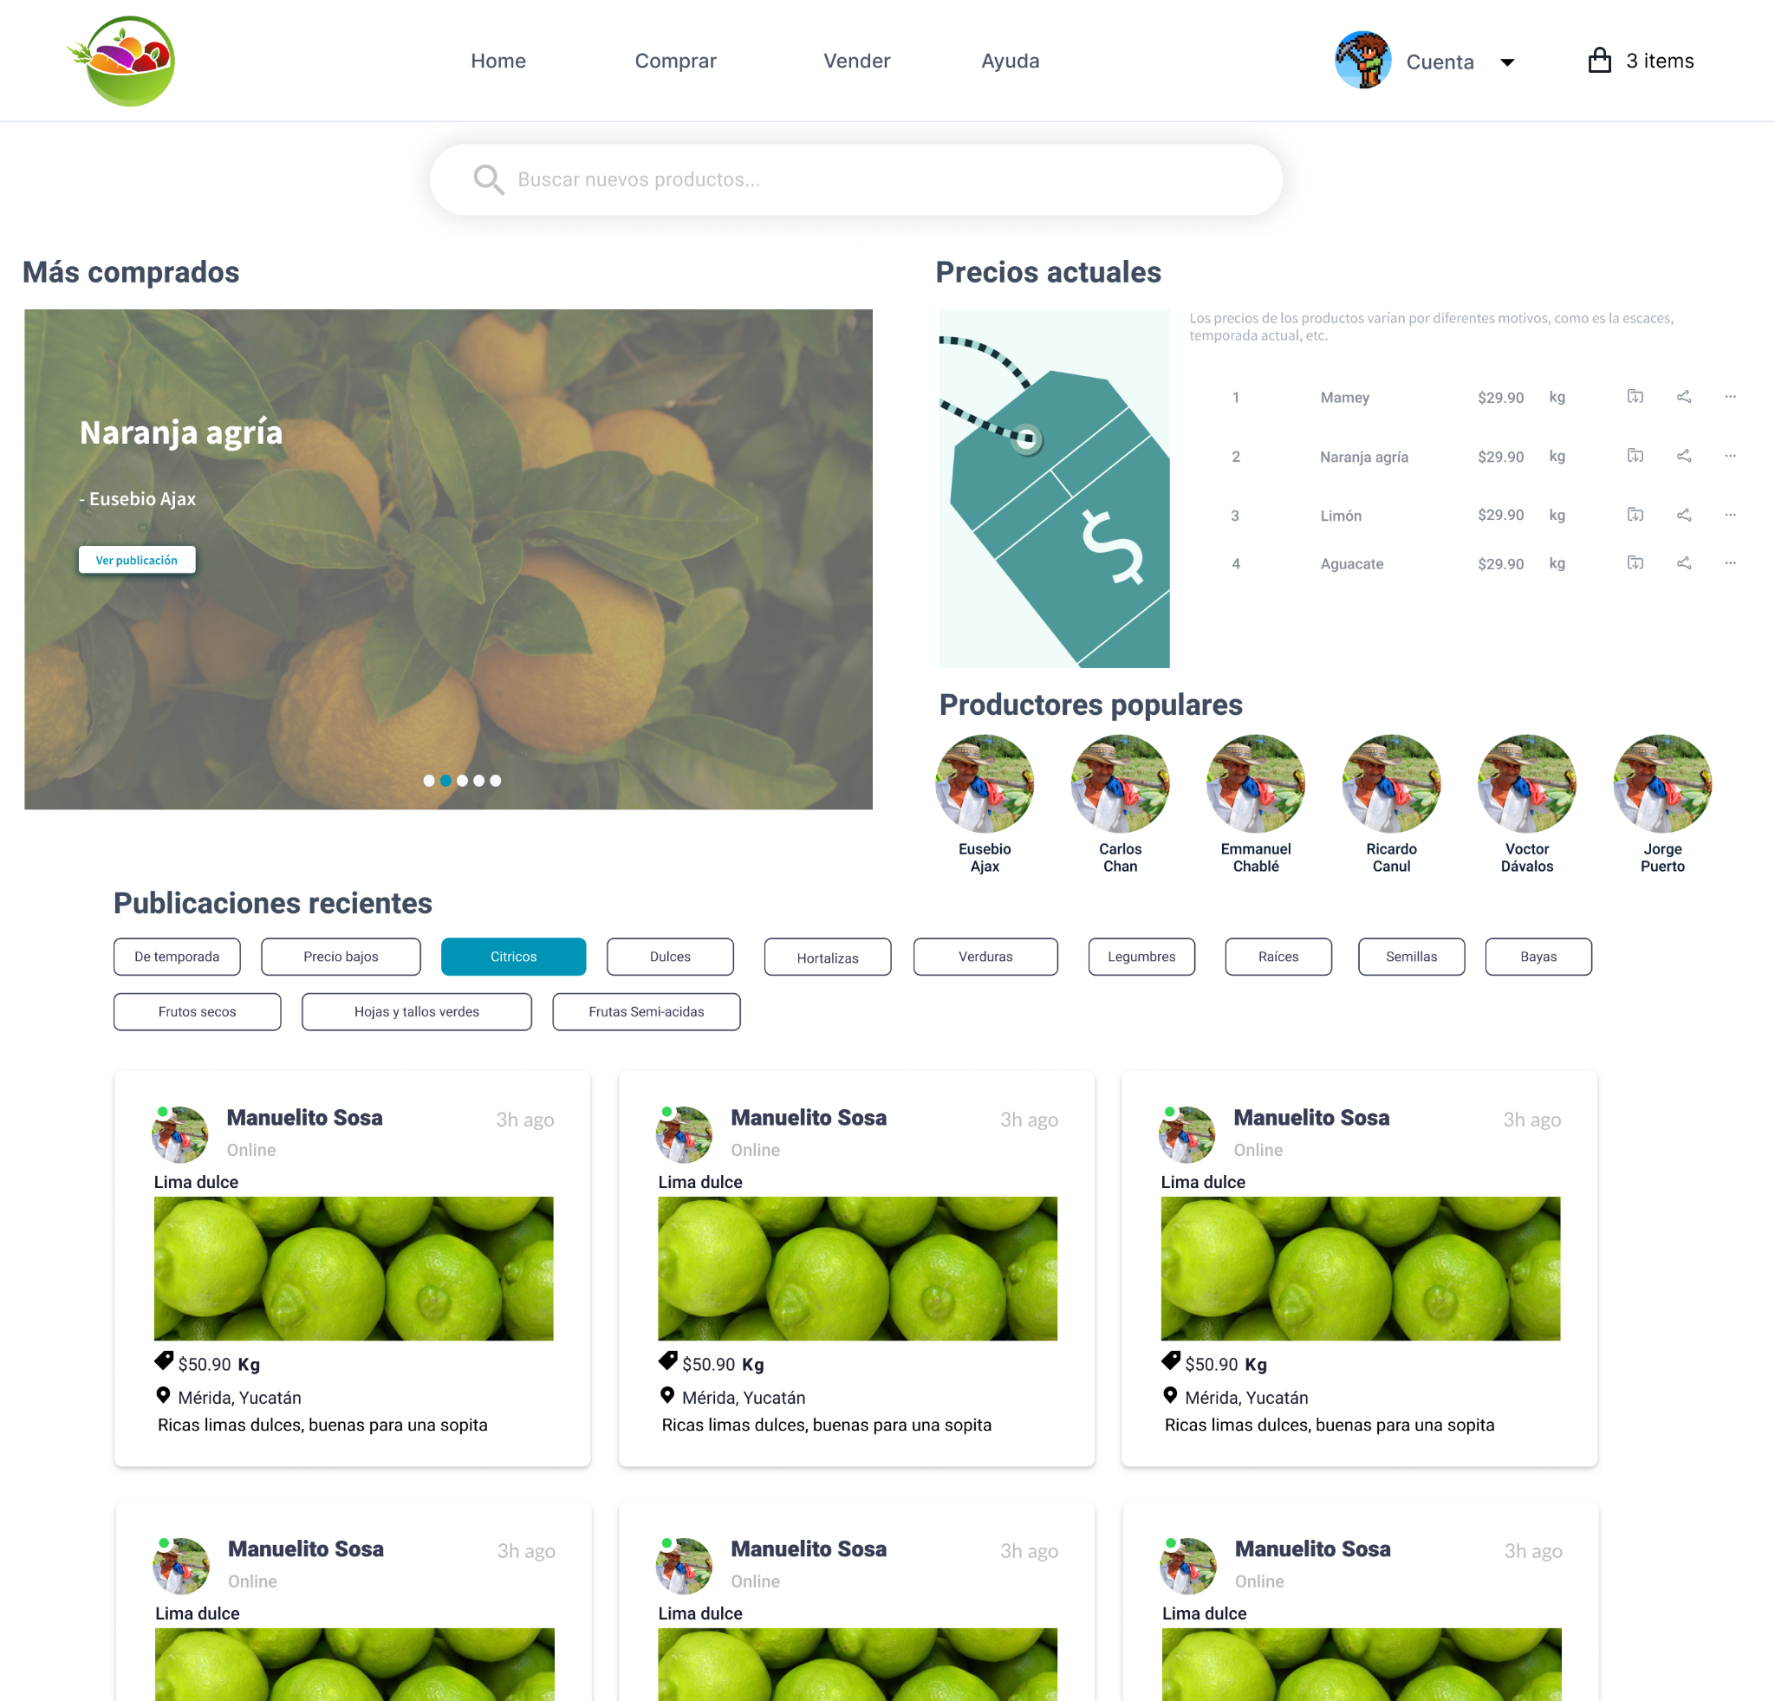

Slide 4
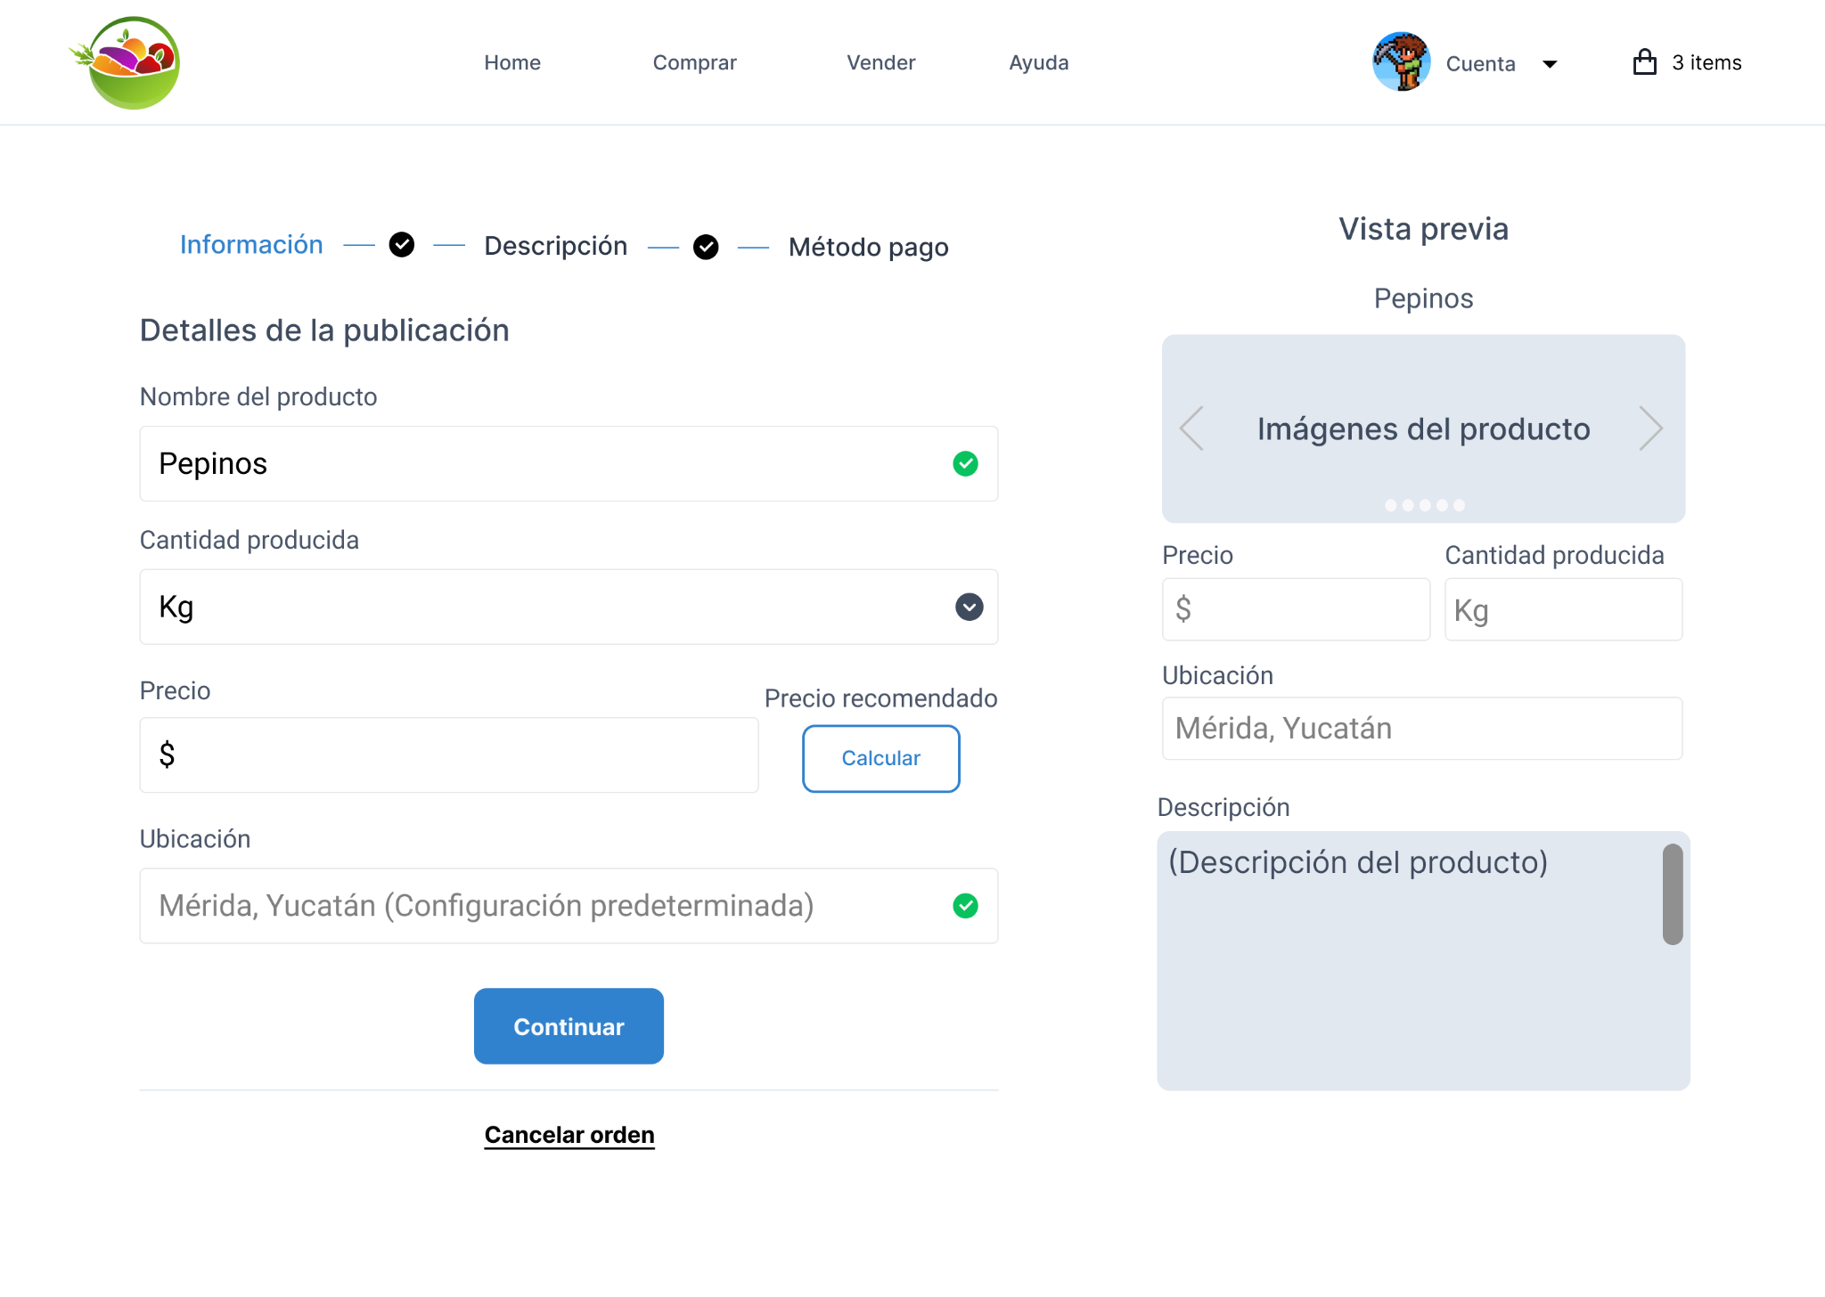

Slide 5
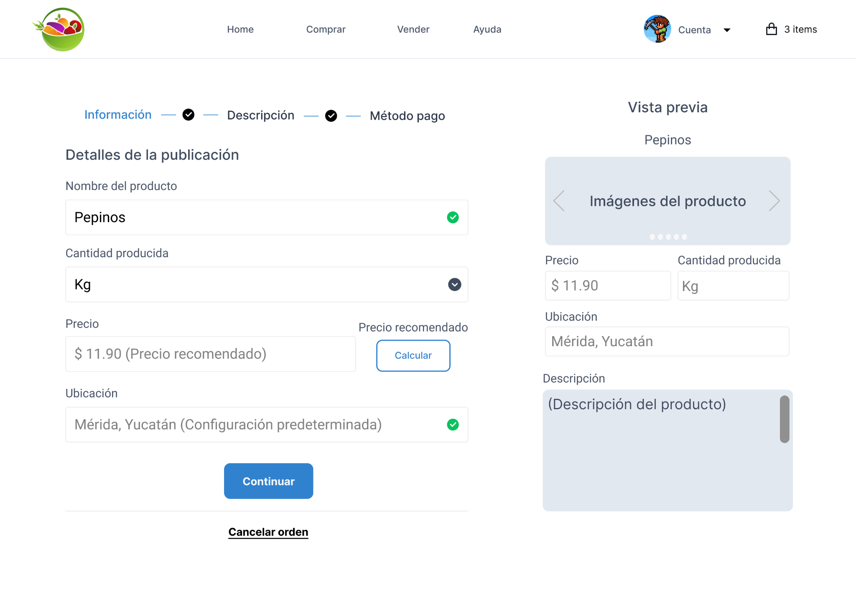

Slide 6
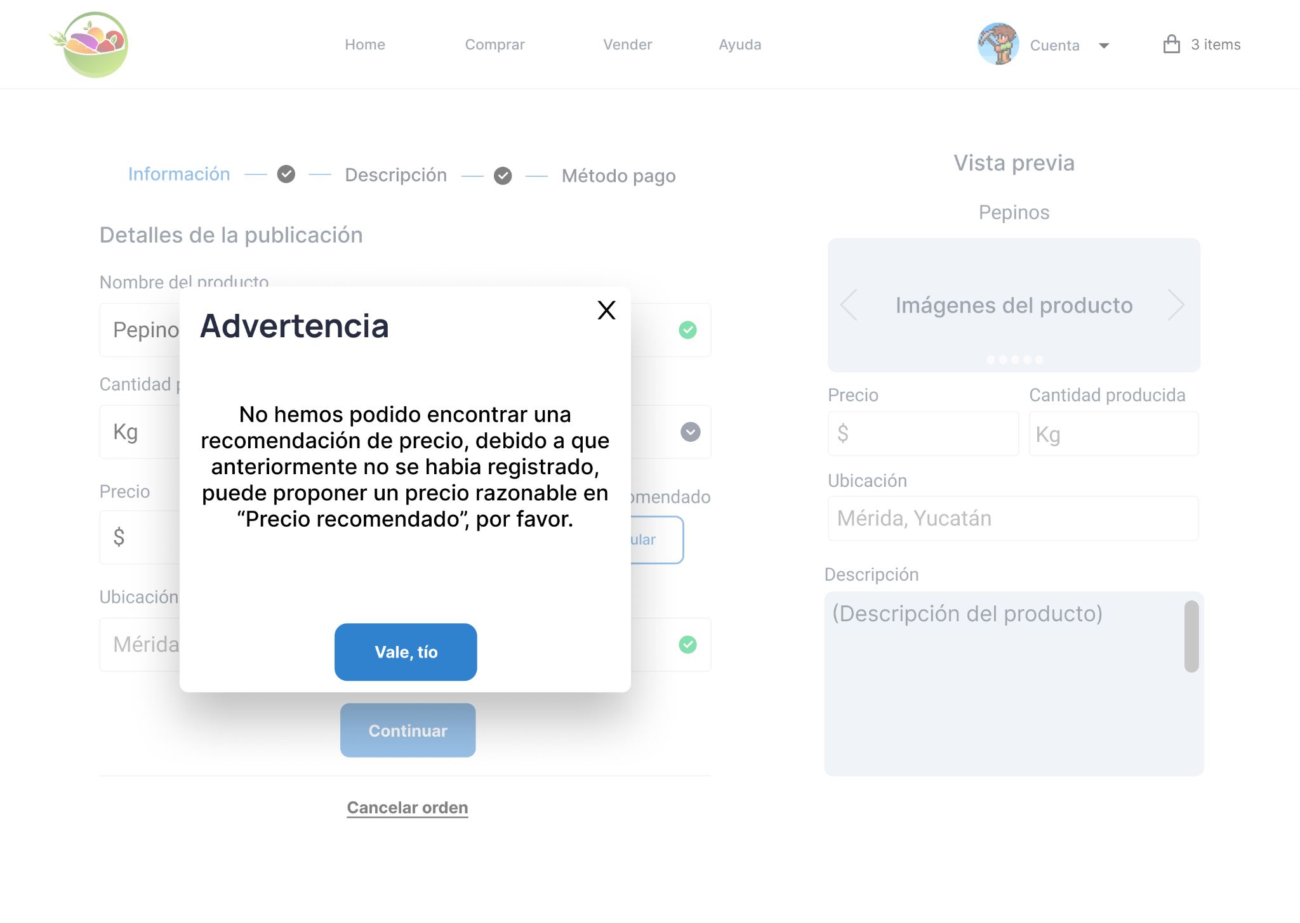

Slide 7
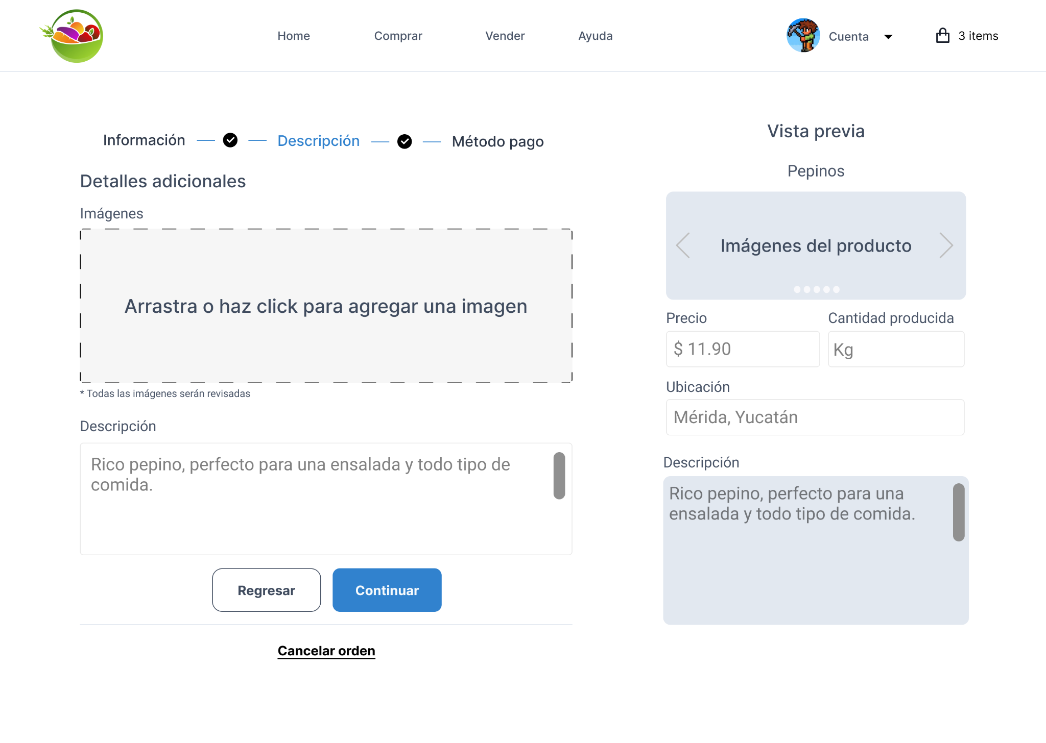

Slide 8
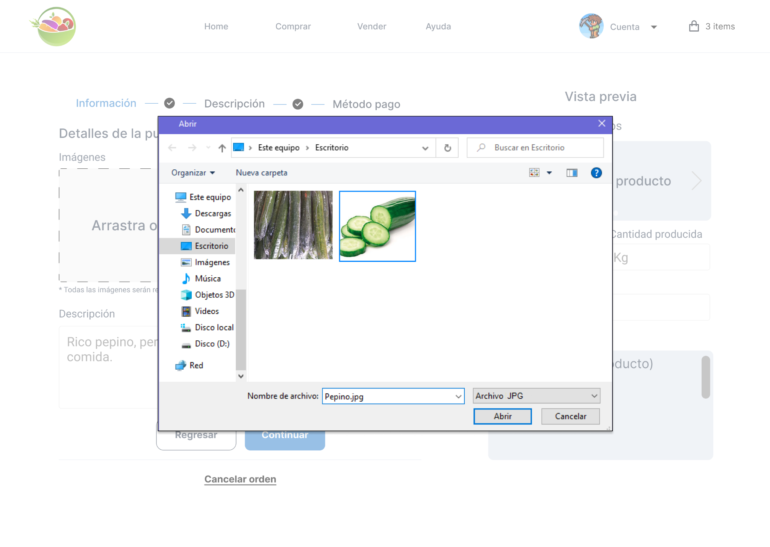

Slide 9
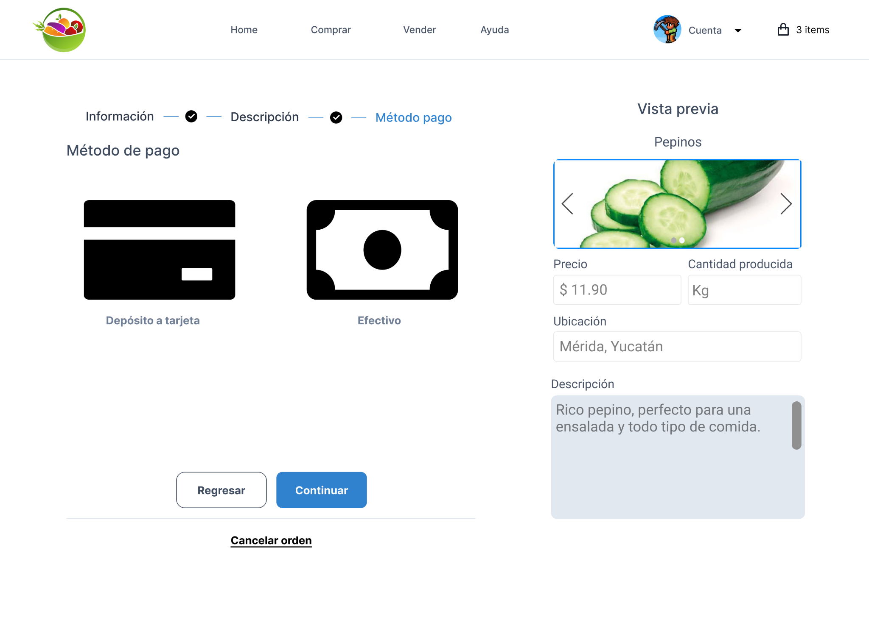

Slide 10
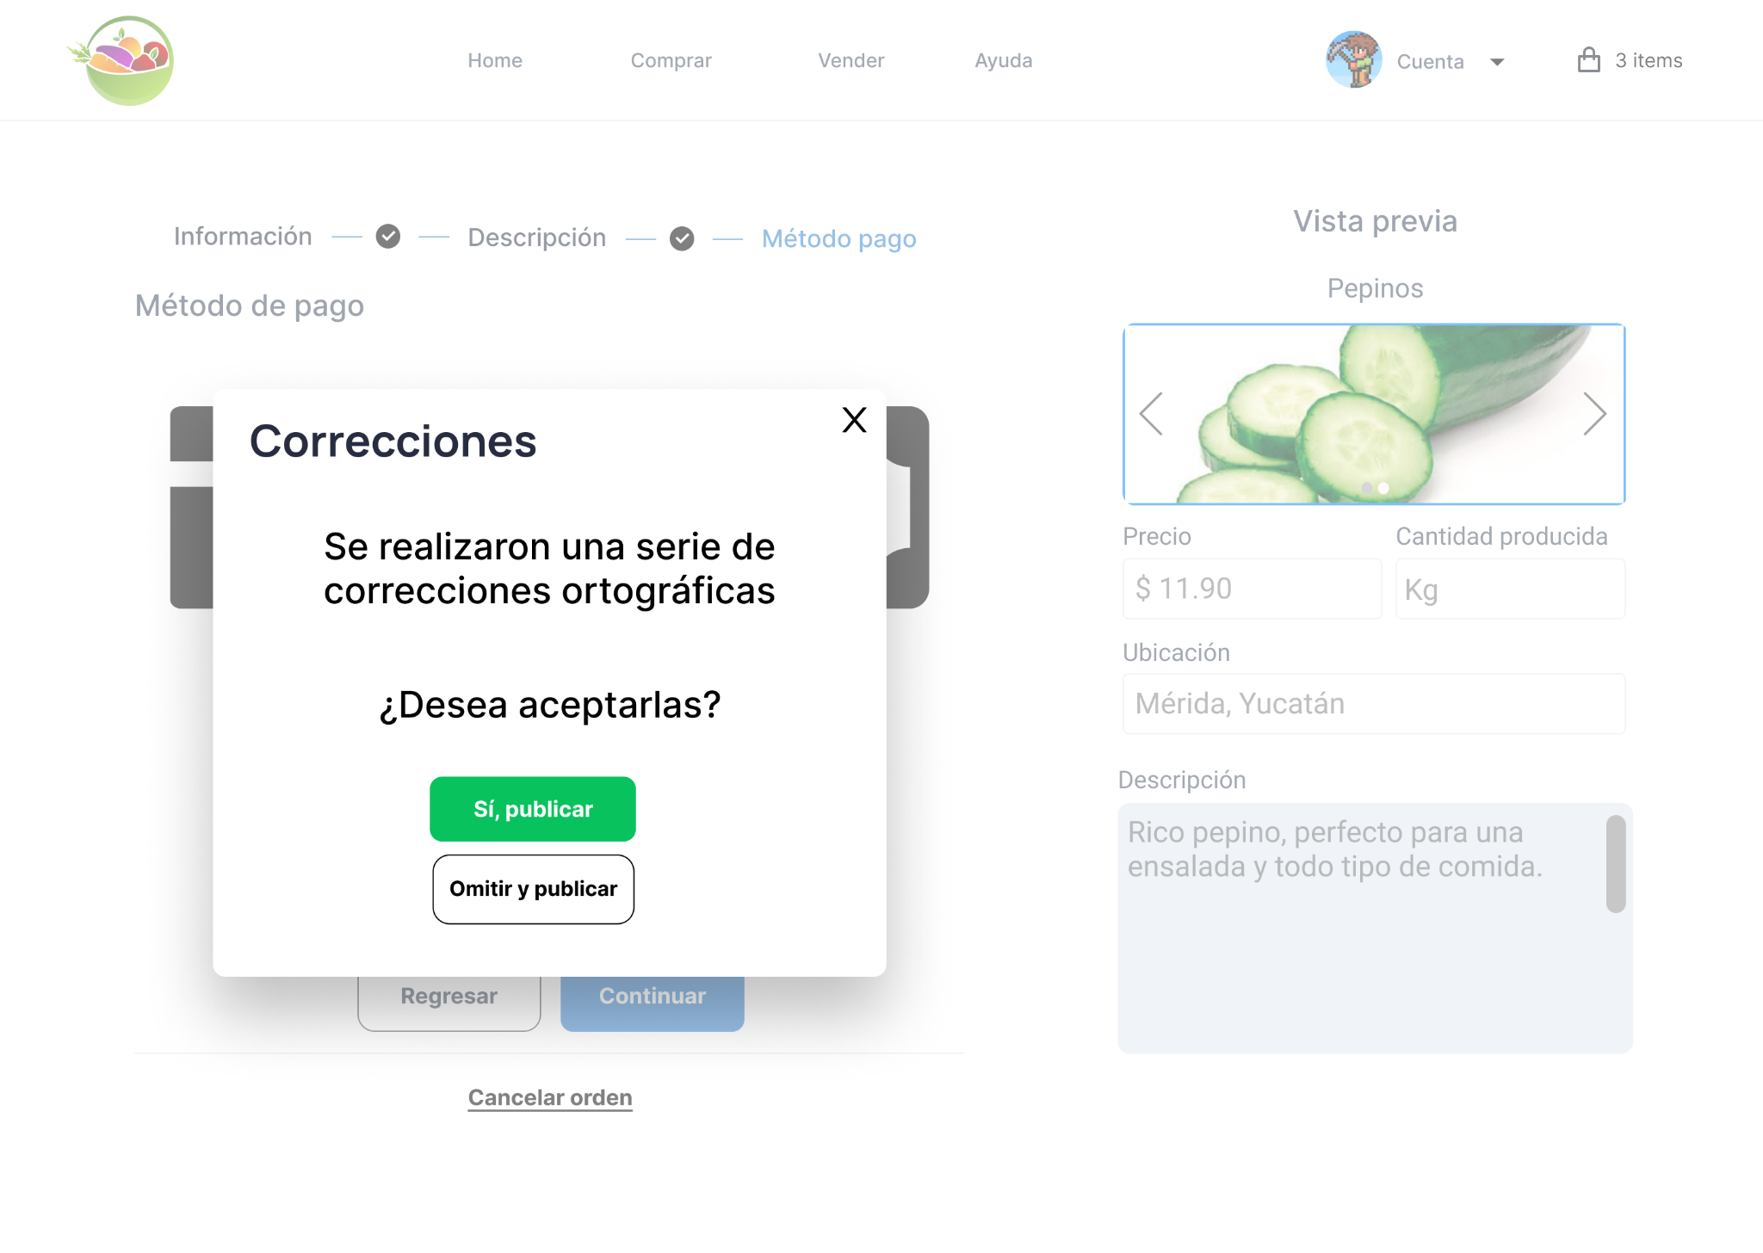

Slide 11


Slide 12
Link del prototipo
https://www.figma.com/proto/0y8Riu3PSY2k9jnDB55j3M/Dise%C3%B1o-preliminar?node-id=46%3A233&scaling=min-zoom&page-id=0%3A1

